Slide 1


Computational Skills for Researchers
Intro to Quest
Alper Kinaci, Sr. Computational Specialist
Research Computing Services
https://github.com/nuitrcs/intro_quest_workshop

Slide 2


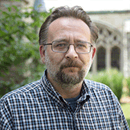


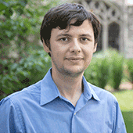

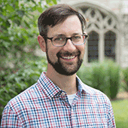
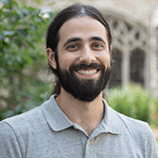
Research Computing: the Consultants
Astronomy
Social Sciences
Materials Science
Data Science Support
Bioinformatics
Cloud Computing
Data Workflow
Visualizations
Animations
quest-help@northwestern.edu

Slide 3
Research Computing: the Consultants
We are a team under Northwestern Information Technology with research backgrounds in computer science, astrophysics, materials science, data science, bioinformatics, and modeling and simulation.
quest-help@northwestern.edu

Slide 4
Research Computing: the Consultants
Providing infrastructure, training, and support for:
Computing
Data processing and analysis Bioinformatics pipelines
Data management, sharing, and storage
Software
quest-help@northwestern.edu

Slide 5
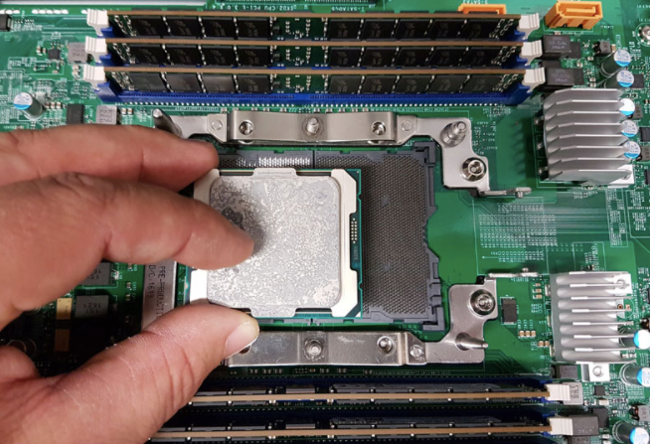
Quest: High Performance Computing Cluster
“node”: a computer
>800
“core”: a processor
>19,200
Notes:
over 100TB of RAM total

Slide 6
Quest: High Performance Computing Cluster
Desktop vs. Quest
Processor Speed: 2.2 GHz
Number of Processors: 1
Total Number of Cores: 2
L2 Cache (per Core): 256 KB
L3 Cache: 4 MB
Memory: 8 GB
1
Processor Speed: 2.5-3.3 GHz
Number of Processors: 2
Total Number of Cores: 24
L2 Cache (per Core): 256 KB
L3 Cache: 30 MB
Memory: 128 GB
800
Notes:
over 100TB of RAM total

Slide 7

Quest: High Performance Computing Cluster
“infiniband”: high-speed
inter-connect
nodes in racks

Slide 8


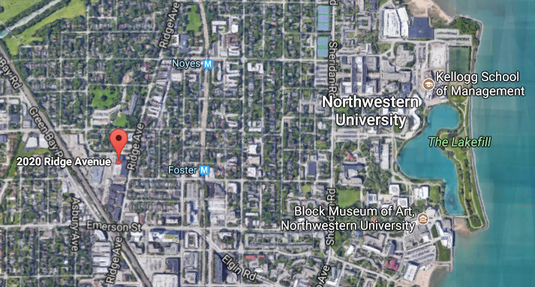
Quest: High Performance Computing Cluster
24 hour on-site security, 3-factor authentication,
firewalls and intrusion detection systems,
dedicated power station, high-throughput network

Slide 9

Quest: High Performance Compute Cluster
Allocation: compute hours, storage space, group
800 compute nodes
3.5 PB
128 GB RAM
/home/netID
Infiniband
/projects/p123
msub
quser10
quser11
quser12
quser13
login nodes
ssh netID@quest.northwestern.edu

Slide 10
Quest: High Performance Compute Cluster
Node Architectures: 3 Generation of Nodes
800 compute nodes
128 GB RAM
Q4 → 20 cores/node
Q5 → 24 cores/node
Q6 → 28 cores/node
Quest 4
Quest 5
Quest 6

Slide 11
Quest: High Performance Compute Cluster
Allocation Types: General Access
Research I: 35K compute hours, 500GB storage
Research II: 500K compute hours, 2TB storage
Classroom: 10K compute hours, 500GB storage
3.5 PB
/home/netID
Infiniband
/projects/p123xx
http://www.it.northwestern.edu/research/user-services/quest/allocation-guidelines.html

Slide 12
Quest: High Performance Compute Cluster
Allocation Types: Buy-in
Full access to compute nodes & persistent storage for 5 years
Buy-in nodes
3.5 PB
/home/netID
Infiniband
/projects/b1xxx
http://www.it.northwestern.edu/research/user-services/quest/full-access.html

Slide 13
Quest: High Performance Computing
Analytics Nodes
The Quest Analytics Nodes allow users to run RStudio and SAS Studio in their web browser, backed by Quest file systems and nodes with more computational resources than available on a personal computer. They are available to all Quest users with an active allocation.

Slide 14
Quest: High Performance Computing
Backing up your data
Northwestern Box: unlimited, free, 15GB single file limit
RDSS (Research Data Storage Service)
& FSMRESfiles (for Feinberg research)
Amazon AWS
Other cloud options

Slide 15
Quest: High Performance Computing
ACTIVITY

Slide 16
Quest: High Performance Computing
Parallel Computing
Multiple jobs working independently
“embarrassingly parallel”
“pleasingly parallel”
high-throughput computing
Single job communicating across nodes
message passing:
MPI, OpenMP

Slide 17
Quest: High Performance Computing Cluster
Software
https://kb.northwestern.edu/quest-software

Slide 18
Quest: Logging in and Getting started
Mac users: launch the Terminal App:
ssh <netID>@quest.it.northwestern.edu
PC users: launch PuTTY (preferred) or FastX:
Hostname : quest.it.northwestern.edu
Username : your Northwestern NetID
Password : your Northwestern NetID password

Slide 19
Quest: Logging in and Getting started
login to Quest
$ssh quest.northwestern.edu
2) where are you?
$pwd -> this is your home directory
3) what is the name of your project allocation?
$groups (your project is in /projects/<allocation>)
4) what is the status of your project?
$checkproject <allocation>
5) how much space is used in your home dir?
$homedu

Slide 20
Quest: Getting started with Cyberduck
To connect to Quest, start Cyberduck and then :
1) Click Open Connection in the upper left of the Cyberduck window
At the top of the Open Connection window that appears, Select SFTP (SSH File Transfer Protocol) from the drop-down menu.
2) Enter quest.it.northwestern.edu for server specification
3) Enter your NetID in the Username: box and leave the Password: box empty to prevent your NetID password from being saved in a file on your personal computer. Public Key Authentication is not supported.
4) Click Connect. You will see a Login failed window.
5) Enter your NetID password in the Password: field.
6) Click Login.​

Slide 21
Quest: transfer intro.tar with Cyberduck
On your local machine
Download the repo zip @ https://github.com/nuitrcs/intro_quest_workshop
Open the zip file (7zip is a quick option http://www.7-zip.org/)
Drag intro.tar into your home directory in Cyberduck
On the command line window that’s logged into Quest
$ ls confirm intro.tar is in the directory that you are in
$ tar xvf intro.tar to unpack the tar file
$ ls look for the unpacked files “submit_generic.sh”, “helloworld.py” and “whereami.sh”
$ cat submit_generic.sh take a look at the header of this file

Slide 22
Quest: submit_generic.sh
#!/bin/bash
#MSUB -A <allocationID> ## <-- EDIT THIS TO BE YOUR ALLOCATION
#MSUB -q <queue_type> ## <-- EDIT THIS TO BE YOUR QUEUE NAME
#MSUB -l nodes=1:ppn=1
#MSUB -l walltime=00:10:00
#MSUB -N sample_job
#MSUB -o outlog
#MSUB -e errlog
cd $PBS_O_WORKDIR ## the directory from which the job was submitted
module load python ## Load necessary modules (software pr libraries)
bash whereami ## Run the program
python helloworld.py ## Run the program

Slide 23


Quest: submitting a job
login node
compute node
“msub submit.sh”
compute node
compute node
scheduler
compute node
#MSUB -A <allocationID>
#MSUB -q <queue_type>
#MSUB -l nodes=1:ppn=1
#MSUB -l walltime=00:10:00
compute node

Slide 24
Quest: sample bash submission script
What is the scheduler looking for in your script?
Behold, this is a BASH script:
#!/bin/bash
#MSUB -A p20XXX
#MSUB -q short
#MSUB -l nodes=1:ppn=6
#MSUB -l walltime=04:00:00
#MSUB -N projectname_mysoftware
#MSUB -o outlog
#MSUB -e errlog
Account:
Queue:
Number of nodes & cores:
Length of the job:
Name the job:
Generate an output log:
Generate an error log:

Slide 25

text editor: vi/vim
On command line: “vi submit_generic.sh”
You land in command mode
To enter insert mode: “i” where the cursor is; “o” inserts one line below that
Navigate with arrow keys
To exit insert mode: “esc”
To save: “:w”
To exit: “:q”
To exit without saving: “q!”

Slide 26
Quest: sample bash submission script
submit your job
$msub submit_generic.sh
2) copy the job_id msub returns
3) where is your job in the queue?
$showq -u <your netID>
4) what is the status of your job?
$checkjob <job_id>

Slide 27
Quest: sample bash submission script
Jobs on Quest
https://kb.northwestern.edu/page.php?id=69247
Example Jobs
https://kb.northwestern.edu/page.php?id=70719

Slide 28
Questions?
email: quest-help@northwestern.edu
Research Computing Services

Slide 29
Python package installation
$ module load python
This will load a development level version of python (2.7) in your environment
$ pip install –user tensorflow –upgrade
Install the package - check in /home/netID/.local
Start python and to test type : import tensorflow as tf
You can exit python by typing: quit() and press enter

Slide 30
R package installation
$ module load R/3.4.3
This will load a development level version of R (3.4.3) in your environment
$ R (enter the R interpreter environment)
> install.packages(‘tensorflow’)
You can click yes to all the options
Check by typing: library(‘tensorflow’)
Exit by typing: quit() and then type n (for no)
Installations will be in home directory under: /home/netid/R/x86_64-pc-linux-gnu-library/3.4/

Slide 31
Build your own package/libraries: fftw
Create a directory and download:
$ mkdir csr; cd csr; wget http://www.fftw.org/fftw-3.3.7.tar.gz
Unpack: $ tar –xvmf fftw-3.3.7.tar.gz
Enter package directory, configure and build
$cd fftw-3.3.7 ; ./configure –prefix=/home/netID/fftw_install ; make ; make install
Inspect installation: $ ls fftw_install
Installation contains directories bin include lib share
Add environmental variables in your /home/netID/.bashrc file:
export $PATH=/home/netID/fftw_install/bin:$PATH
export $LD_LIBRARY_PATH=/home/netID/fftw_install/lib:$LD_LIBRARY_PATH
export $PKG_CONFiG_PATH=$LD_LIBRARY_PATH/pkgconfig:$PKG_CONFIG_PATH

Slide 32
Build your code
Download a sample code that needs your libraries
$ wget http://geco.mines.edu/files/userguides/techReports/mklWrappers/fft_example/test.c
Compile:
$ gcc test.c -o test \
-L$HOME/fftw_install/lib -lfftw3 -lm \
-I$HOME/fftw_install/include
Run:
./test >& output
Compiler-Source-Exec
Linking to libraries
&headers

